Slide 1


Slide 2
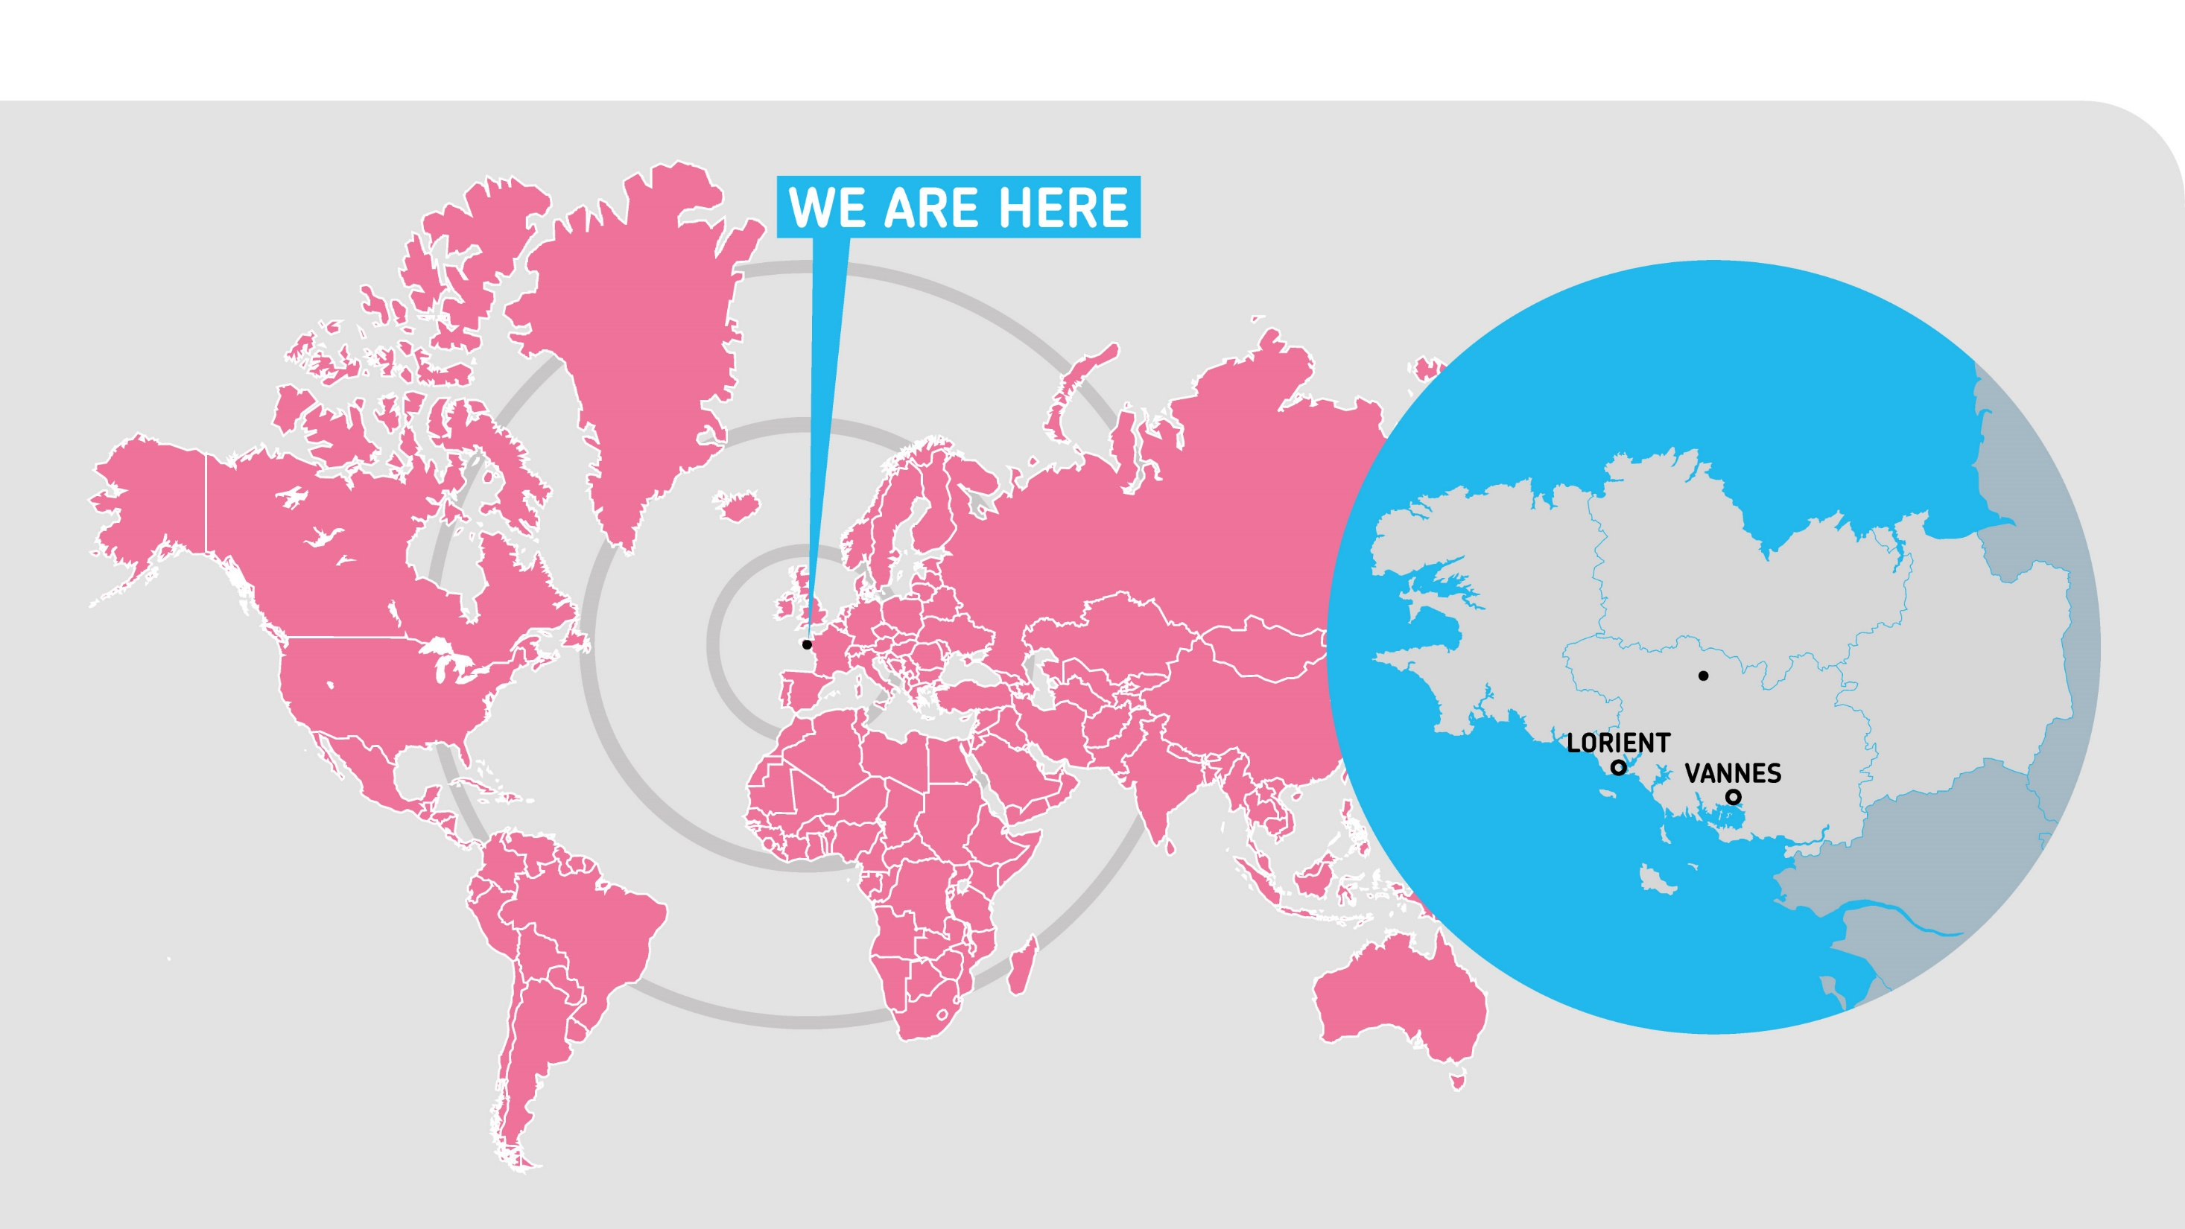
UNIVERSITÉ BRETAGNE SUD
Founded
1995
2 main
campuses
Notes:
University of South Brittany (Université Bretagne Sud) was founded in 1995. It is a multidisciplinary institution with two main campuses situated in Lorient and Vannes, Brittany, France. It has developed recognized research skills in
4 major fields: materials, costal and marine studies, social usages and practices, IT.

Slide 3
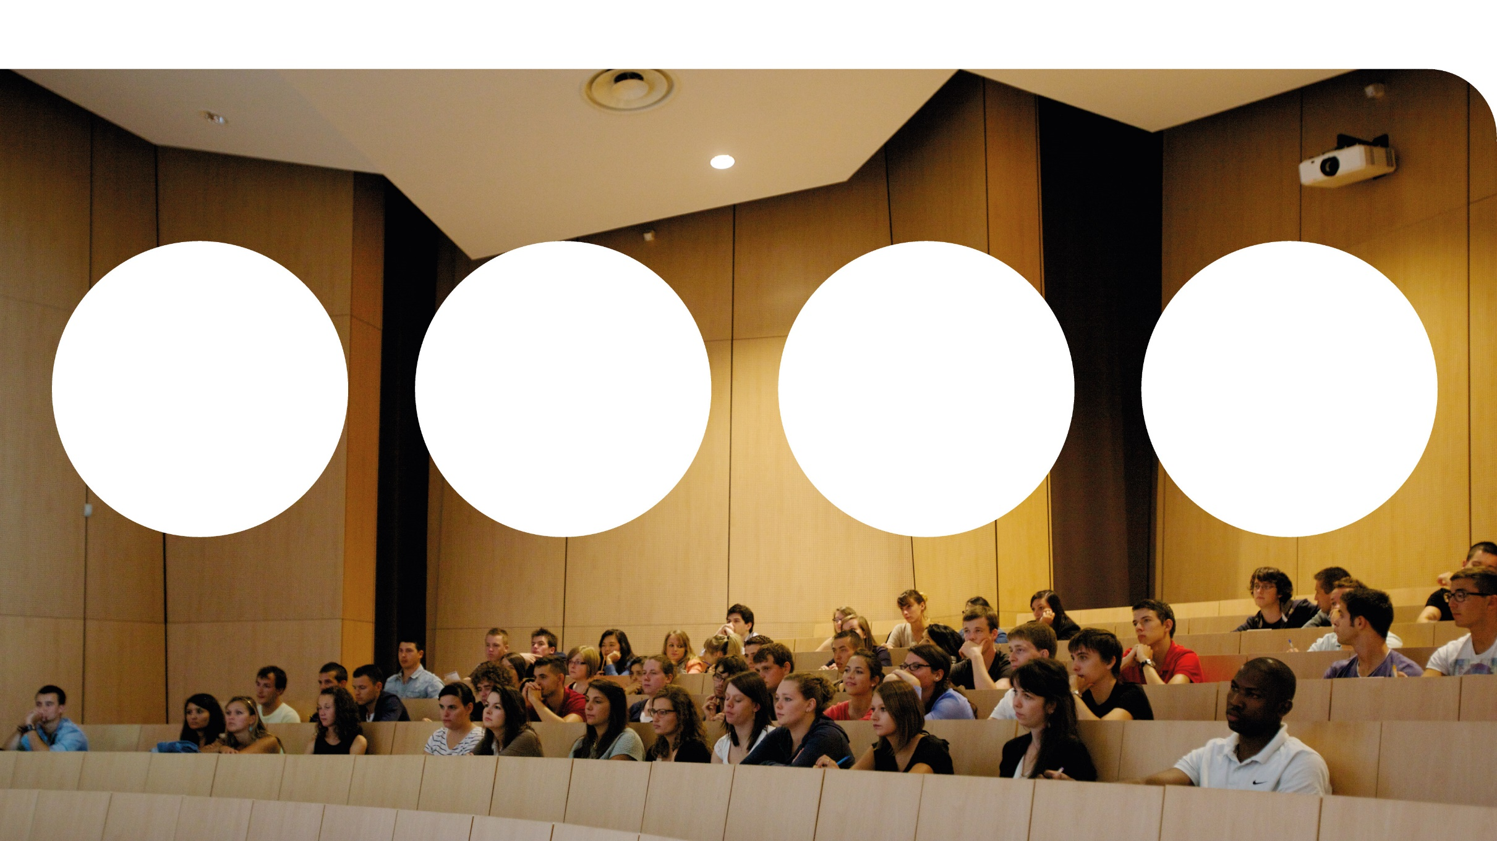

KEY FIGURES
100 academic programs from Bachelor level to Ph.D.
987 staff
500 faculty members
11 000
students
14 research
laboratories

Slide 4

OUR STRENGTHS
4 Poles of Excellence
Environment, health & disability
Sea and Coastline
Cyber & Data Intelligence
Industry of the future
Multidisciplinary
Sciences and Technology
Law, Economics and Management
Languages, Humanities
and Social Sciences
Partnerships
with community
and companies
Partners are involved
in course design
Lecturers from partner enterprises
Compulsory Internships
& Traineeships
Core Values
Team spirit
Audacity
Civic engagement
Dedication
Notes:
University of South Brittany places special emphasis on: student life and welfare,
innovation (e.g. new master’s program in cyber defense; co-op programs at all levels; new technological platform on high-performance materials);
top-edge research;
industry partnerships and technology transfer and
international student mobility.
University of South Brittany is YOUR University

Slide 5
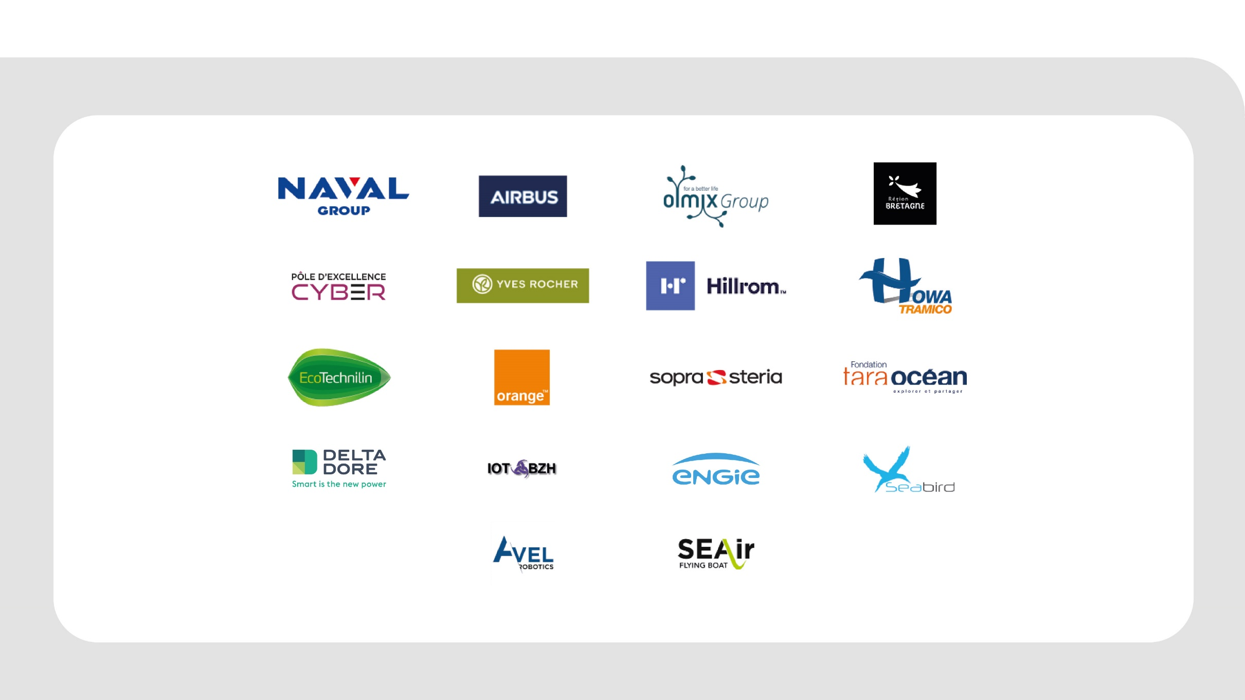
SOME OF OUR KEYS PARTNERS

Slide 6

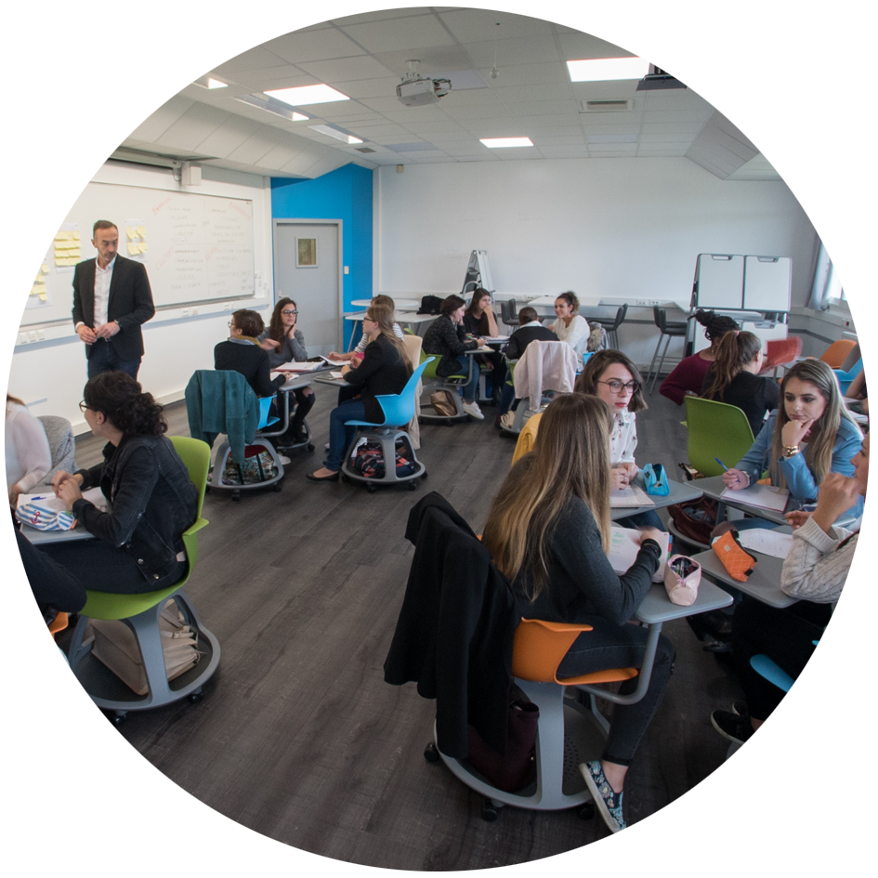
5 REASONS TO STUDY AT UBS ?
1
Train for qualifications and new jobs most needed in the future
and most sought after by employers
3
Work in small groups with dedicated academic teams
5
Flourish in an amazing natural and caring environment
2
96 % of our students are employed within 18 months
4
Be involved in the latest most amazing R&D activities

Slide 7
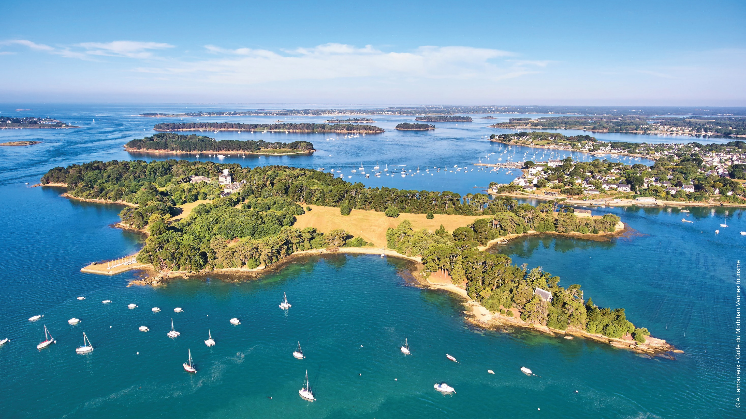

Slide 8

6 FACULTIES, INSTITUTES AND SCHOOLS
Notes:
Faculty of Languages, Humanities and Social Sciences
• Faculty of Sciences and Engineering
• Faculty of Law, Economics and Management
• 2 Institutes of Technology
• School of Engineering

Slide 9

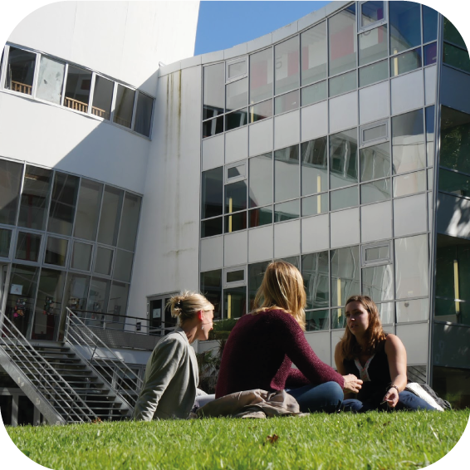
LANGUAGES - HUMANITIES AND SOCIAL SCIENCES
Bachelors
• History
• Languages:
- Applied Business
- Literature and Civilisations
• Import /Export Commercial Assistant (Voc)
• French literature
Masters
• History, Civilisation and Heritage
• Geography, Urban and Environmental planning
• Printing and Publishing Careers
• Masters in Regional or European Project Management
• International Development (Voc)
• Languages, Literature and Civilisations

Slide 10

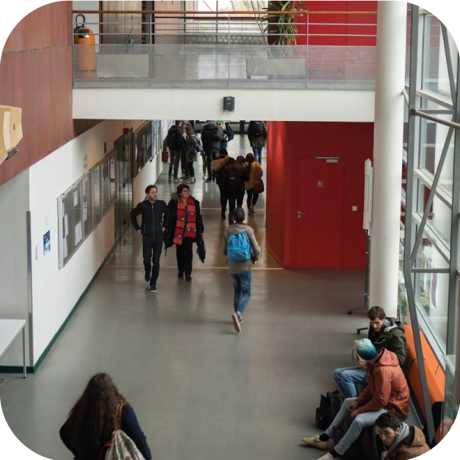
SCIENCES & ENGINEERING SCIENCES
Bachelors
• Mathematics
• Computer Technology
• Life sciences
• Ecology and Society
• Engineering Sciences Civil engineering, Mechanical engineering, Energetic)
Masters
• Biotechnology
• Chemical ecology
• Computer Sciences
• Design Engineering
• Complex System Engineering
• Applied Mathematics and Statistics*
• Environmental Sciences, Earth and Planets
*Available Online

Slide 11

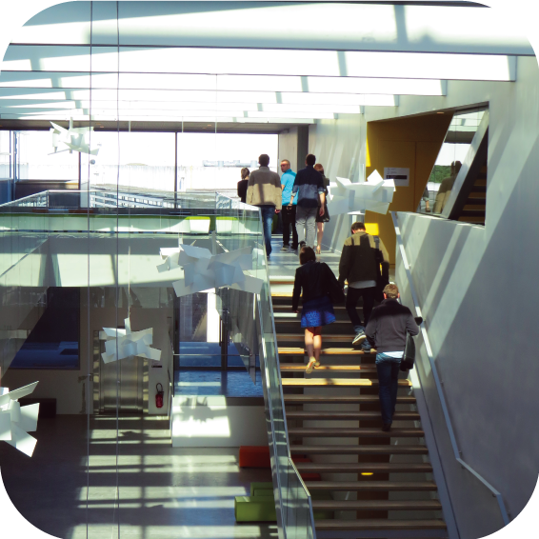
LAW - ECONOMICS - MANAGEMENT
Bachelors
• Law
• Economics and Management*
*Year 3 specialisation in Accounting and Finance, Marketing and Sales
Applied Economics, Economics and Business Management
Voc Ba in Human Resources, Banking and Insurance, and Agribusiness.
Masters
• Public or Private Law
• Accounting, Control and Audit
• Organisational Management and Auditing Information Systems
• Marketing and Sales
• Human Resources
• Banking and Financial Advice
• Wealth Management

Slide 12

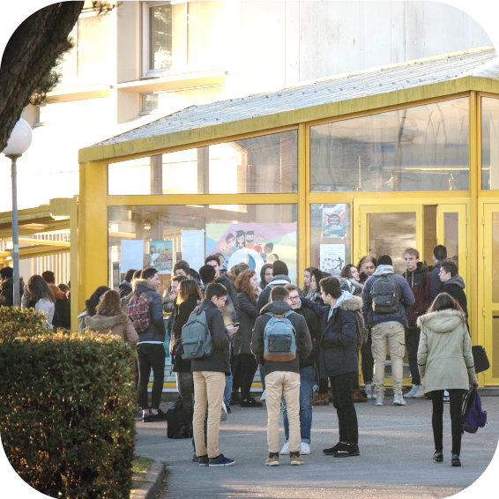
VANNES INSTITUTE OF TECHNOLOGY
Vocational Bachelors of Technology
• Computer Technology
• Decision Support Systems
• Sales and Marketing
• Business Management (Accounting and Human Resources)

Slide 13

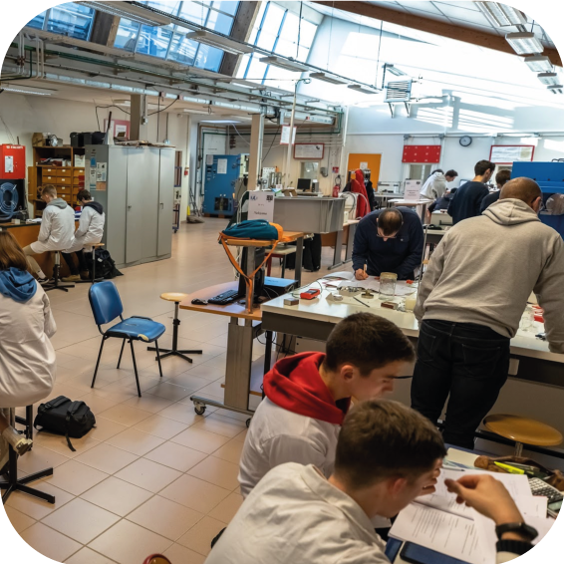
LORIENT AND PONTIVY INSTITUTES OF TECHNOLOGY
Vocational Bachelors of Technology
• Risk Management, Health and Safety at Work
• Energy Management
• Industrial Engineering and Maintenance
• Logistics and Quality Control Management
• Processes and Chemical Engineering

Slide 14

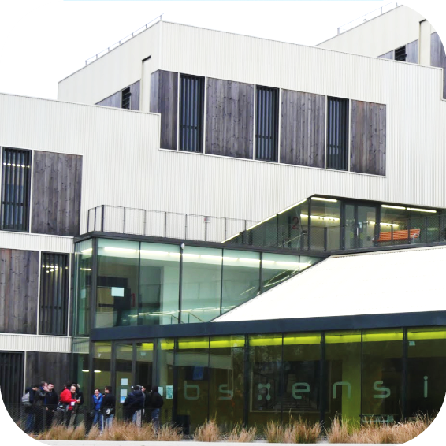
UNIVERSITY SCHOOL OF ENGINEERING
Mechatronics
Cyber defense
Trusted Computing
Civil engineering
Industrial engineering
Courses in English: https://www-ensibs.univ-ubs.fr/fr/international/english-presentation.html

Slide 15


OUR RESEARCH
  14 research
  laboratories
Including several certifications from the National Center for Scientific Research - CNRS
4 Centres of Excellence
at the crossroads of education, research, innovation and corporate services:
Environment, health & disability
Sea and Coastline
Cyber & Data Intelligence
Industry of the future

Slide 16
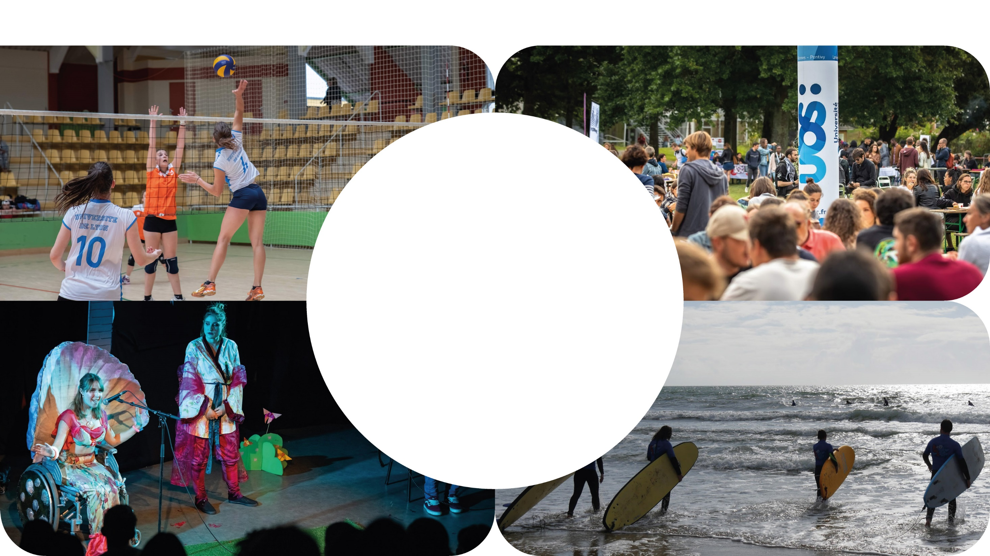
STUDENT ACTIVITIES
40 students
associations
200 cultural, social
or artistic events per year
Over 40 sport activities including
surfing, sailing, kiteboarding, diving,
hiking, futsal, self defense for women,
dance, yoga, basketball,
swim and run etc.
Highlights: English week,
Science Party, Robofesta,
Welfare Week, Welcome Deiz,
Theater Festival …

Slide 17
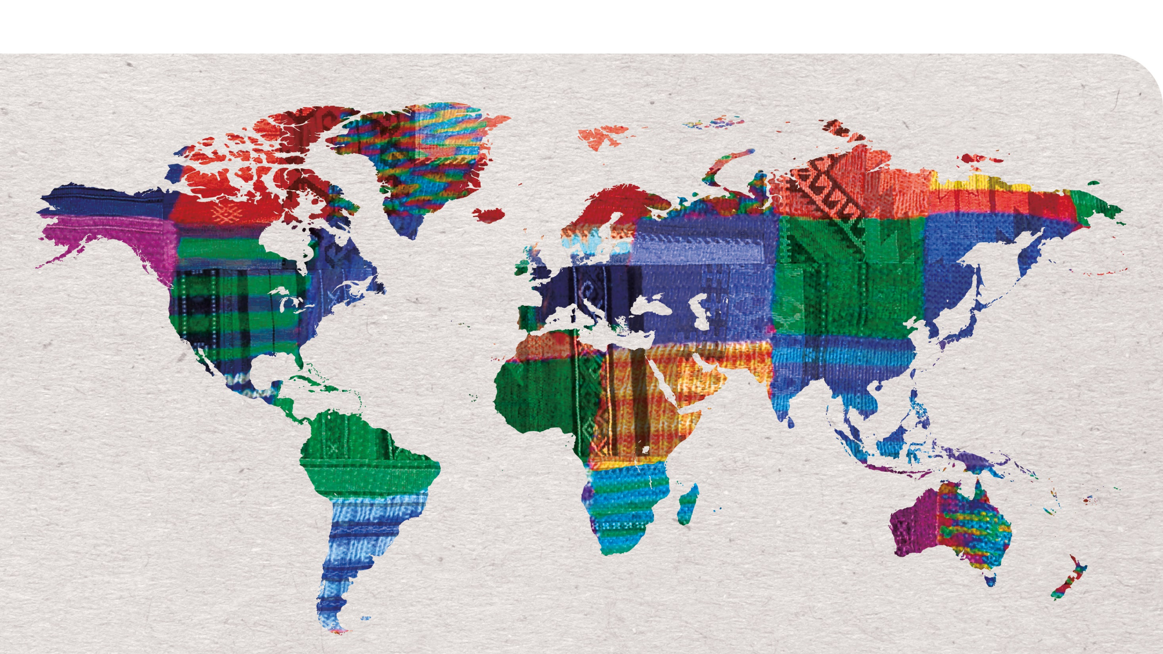
INTERNATIONAL RELATIONS

Slide 18
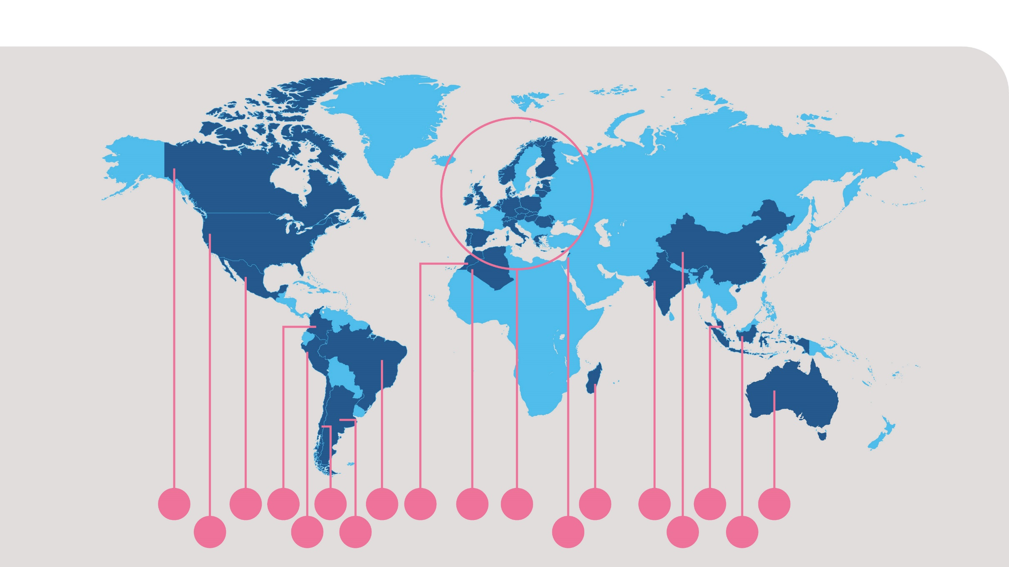
INTERNATIONAL AGREEMENTS
25
3
2
1
3
3
4
82
4
3
2
4
1
1
2
1
4
1

Slide 19

INTERNATIONAL PROGRAMS
UBS offers programs internationally orientated including courses taught in a foreign language or given by foreign lecturers, a compulsory mobility abroad, or the possibility to apply for a double degree.
UBS is involved in the Erasmus+ mobility program with program and partner countries and develops various cooperation activities under bilateral agreements.
UBS proposes:
5 degrees with a compulsory semester abroad
6 double Degrees (Ba, Ma)
2 Erasmus Mundus Joint Master: CYBERUS and Copernicus Master in Digital Earth
1 Erasmus+ Strategic Partnerships in Acountancy and Auditing
1 joint degree supported by the French and German University with 3 European Univesities (France, Germany, Czech Republic) Master in Regional and European Project Management

Slide 20

INTERNATIONAL STUDY OFFER
Semester courses in English
Business Management and Marketing
Eco-design of polymers and composites
Industrial engineering 4.0
Mechatronics
Cybersecurity
Intensive
or
semi intensive
French language
courses

Slide 21
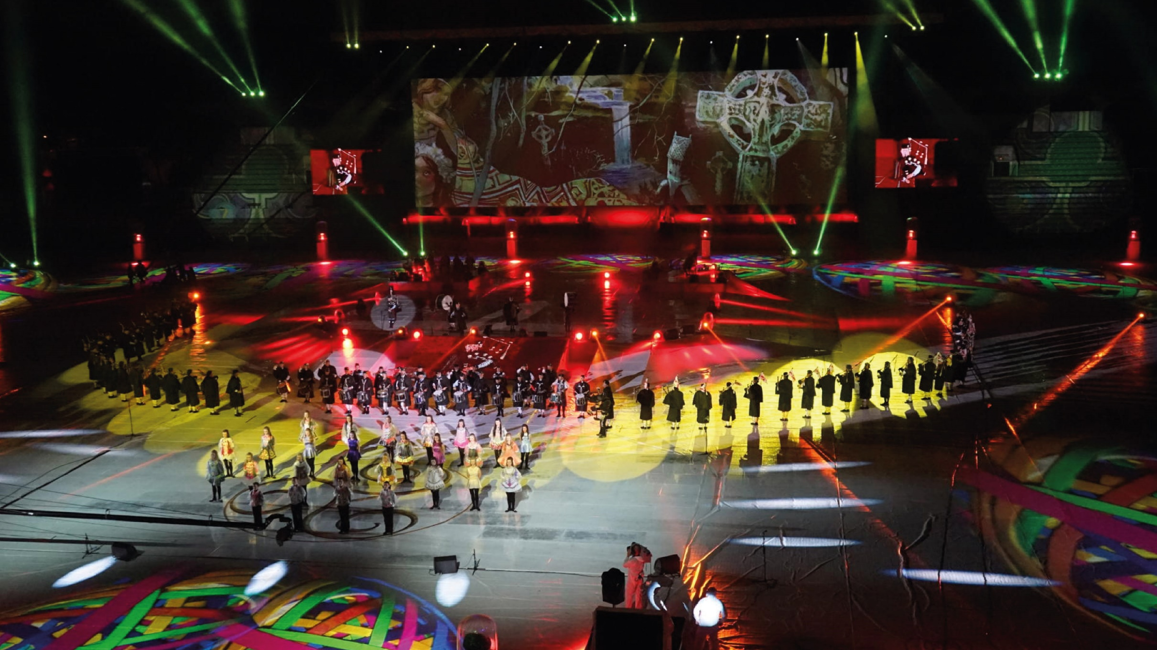
Notes:
Brittany is one of the biggest festival destination in Europe and in the world with over twenty festivals each summer. The international Celtic festival in Lorient attracts over 800 000 tourists each year.

Slide 22
